Slide 1
A diagram editor to mechanise categorical proofs
Ambroise Lafont (PARTOUT)
23 November 2023
Notes:
Bonjour, je vais vous presenter mon porfil autour des langages et preuves mécanisées pour un poste de charche de recherche de classe normale au CNRS
Je suis actuellement en postdoctorat depuis 2022 a l’universite de Cambridge. Apres un premier doctorat a l’universi entre 2020 et 2022, suivant ma these
A quoi ca sert de verifier un compilateur
Precedemment, j’etais
Pas assez articule
Je parle trop vite
Variable binding and substitution for (nameless) dummies

Slide 2

A bit of history
It all started with Covid19.

Slide 3
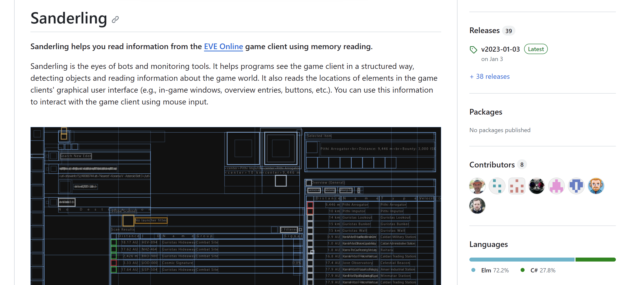

?

Slide 4

Elm: A delightful language for reliable web applications.
“[My favorite thing] is the feeling of joy and relaxation when writing Elm code.”
Luca Mugnaini, Software Engineer, Rakuten
Concretely:
A functional programming language that compiles to JavaScript
A simple reactive architecture
THE ELM ARCHITECTURE
init : ( Model, Cmd Msg )
update : Msg -> Model -> ( Model, Cmd Msg )
subscriptions : Model -> Sub Msg
view : Model -> Html Msg

Slide 5
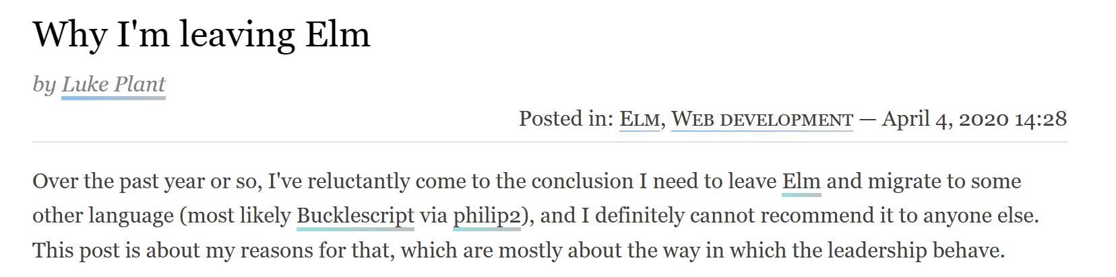
Afterthoughts: why you should not program in Elm
Is it still a thing?
Alive slack (with occasional job opportunities), weekly newsletter, bimensual podcasts, …
But last compiler release: v0.19.1, Oct 2019
Terrible JavaScript FFI
Asynchronous calls to JS only, as commands
(intentional!)

Slide 6
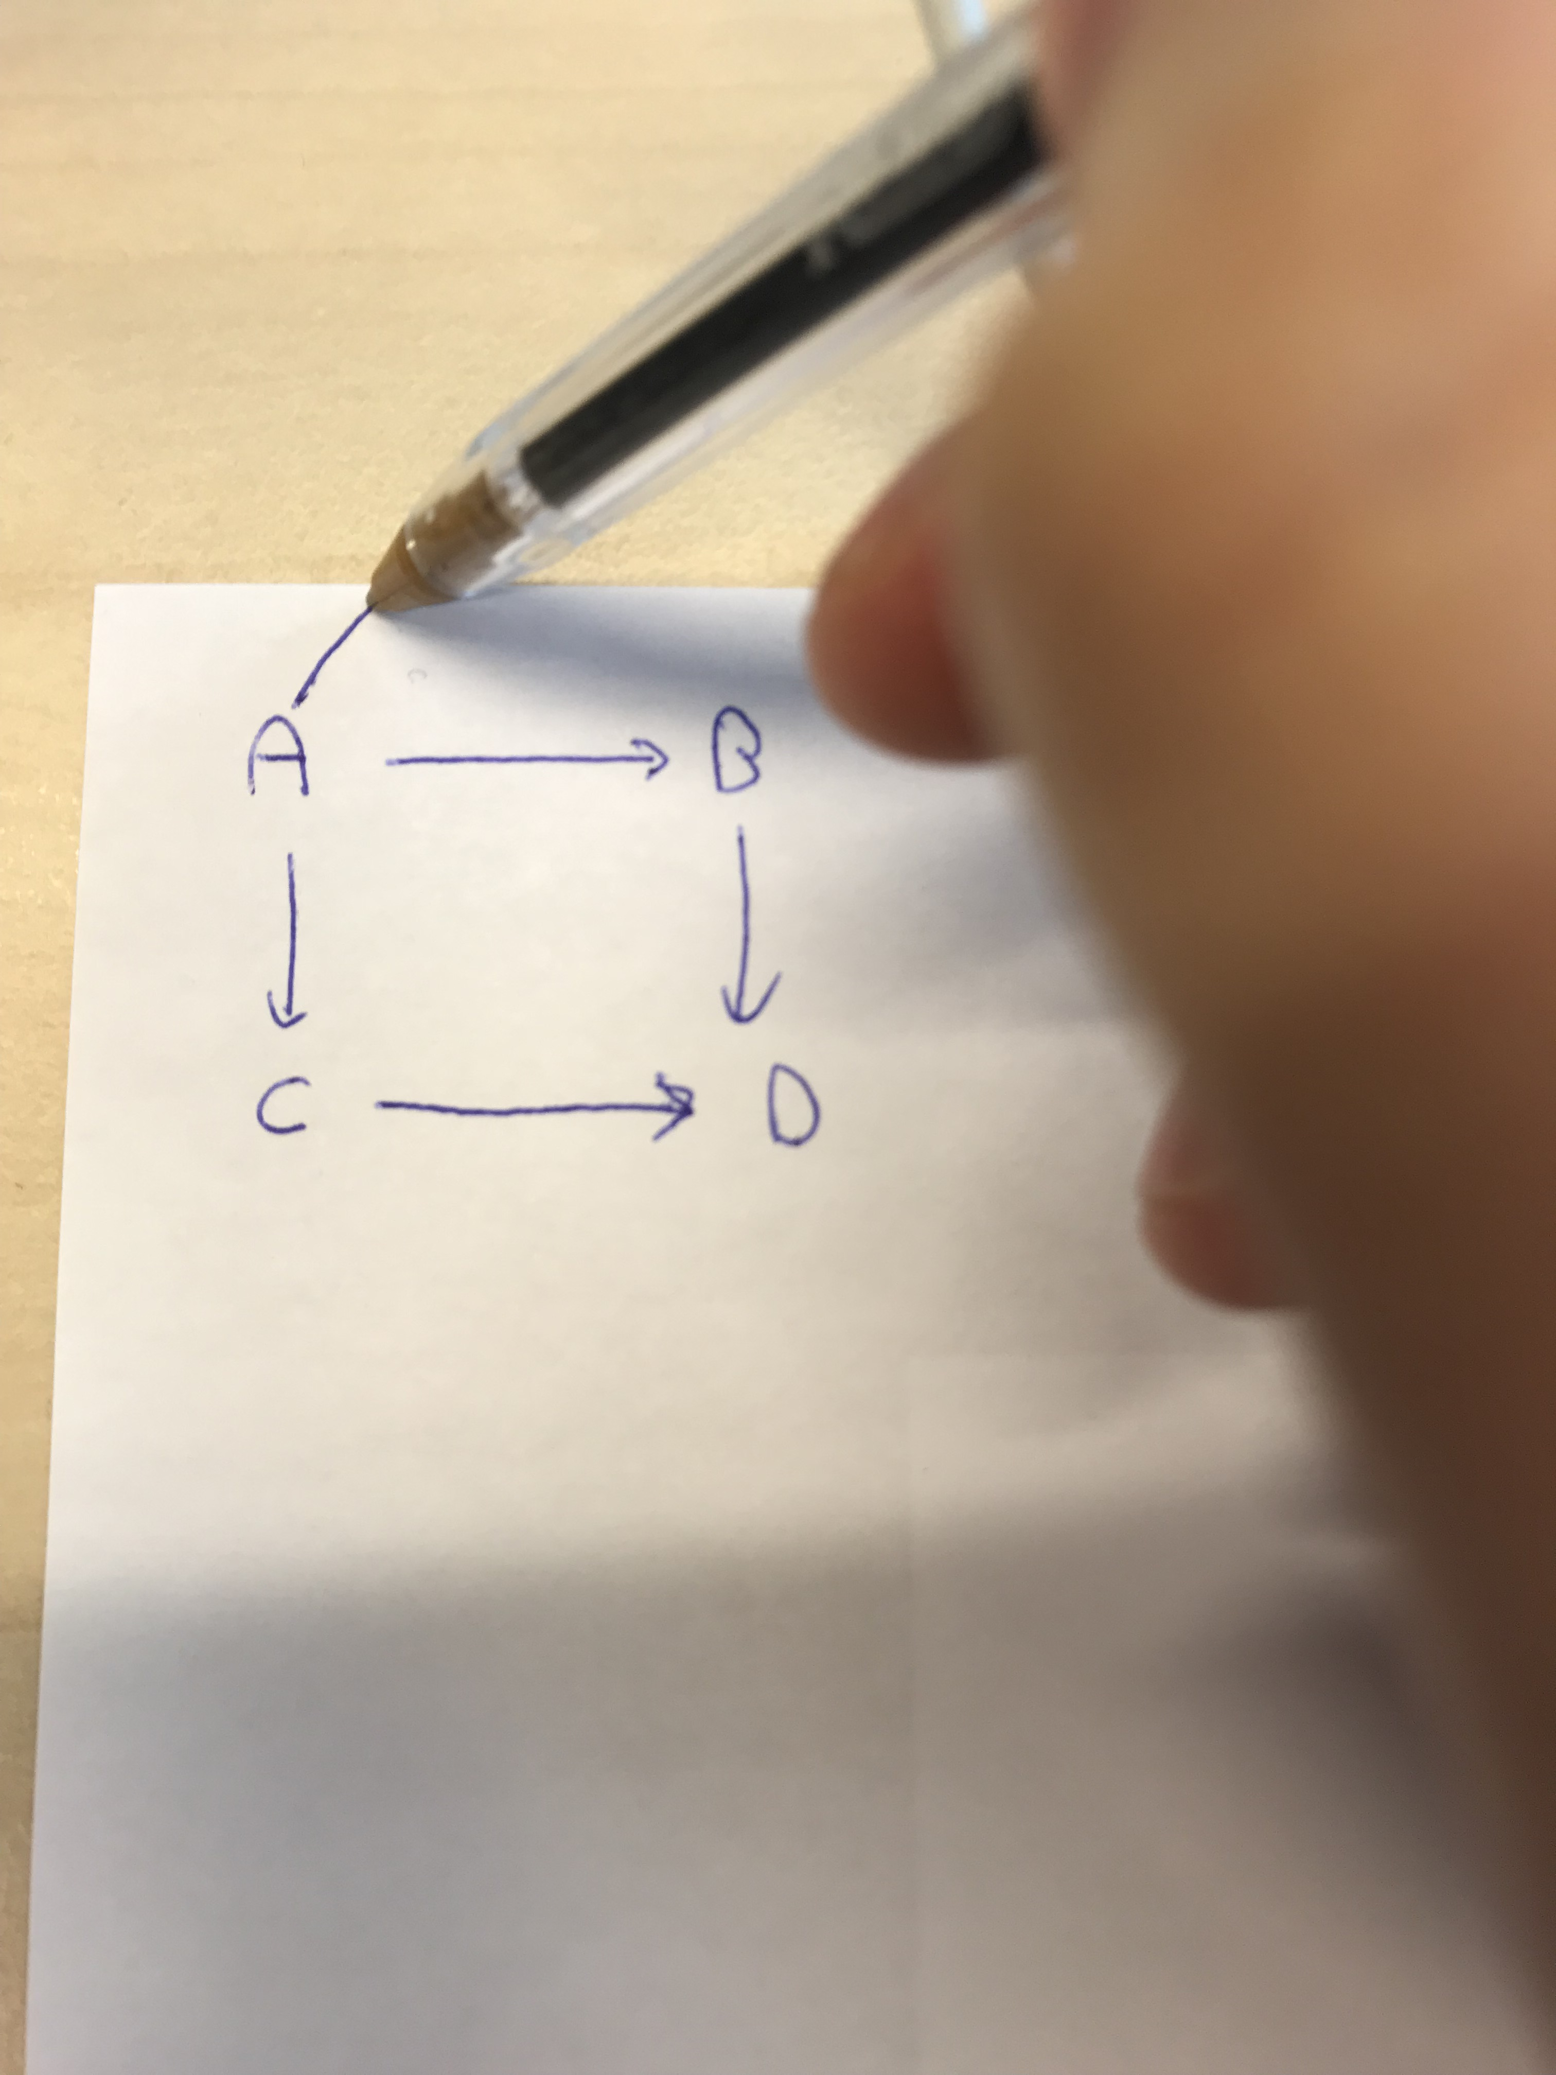
2020: I need a pretext to program in Elm
A game?
Too old for this…
A categorical diagram editor
Drawing on paper is inconvenient:
no way of reorganising the diagram without redrawing everything.
DEMO

Slide 7
How to test the editor
A web app that runs locally in your browser
A standalone desktop program
Embeds the web app using electron
Additional features
https://amblafont.github.io/graph-editor/index.html

Slide 8
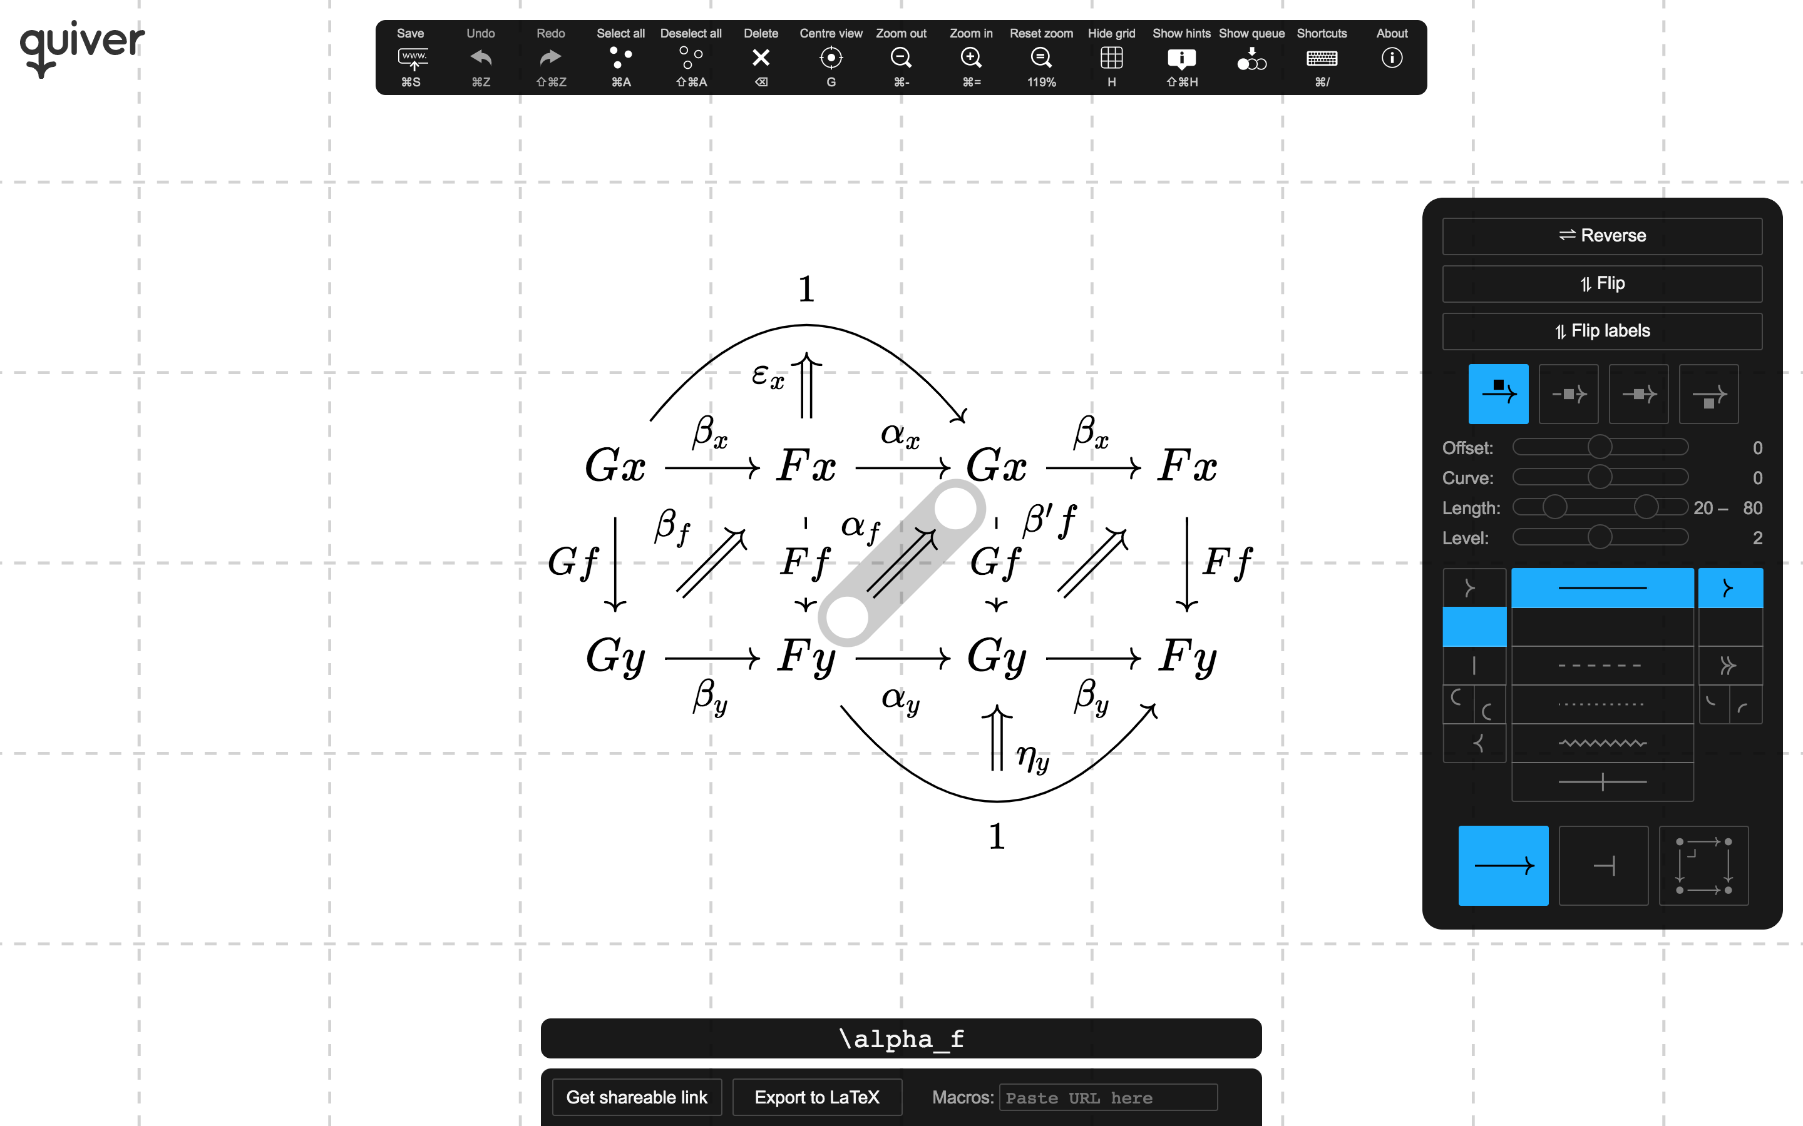
Nov. 2020: An existential crisis
Nathanel Arkhor releases quiver, “a modern, graphical editor for commutative and pasting diagrams, capable of rendering high-quality diagrams for screen viewing, and exporting to LaTeX via tikz-cd.”
That’s what I have been looking for!
Can I implement my own editing style and shortcuts on top of it?
In principle yes, but…
it is implemented in JavaScript 😱

Slide 9
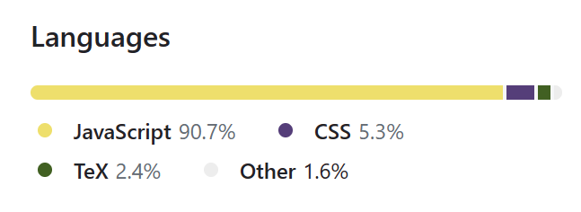
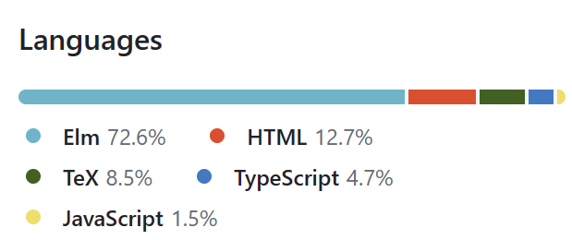
Comparison with quiver
About the same size (around 10k of LoC)
 | Quiver | My editor
Programming Languages | JavaScript + React
Styling options | + | -
User-friendly | + | -
Editing features | - | + Tabs, copy & paste, find & replace, expand selection to connected components, …

Slide 10
Comparison with quiver
About the same size (around 10k of LoC)
 | Quiver | My editor
Programming Languages | JavaScript + React
Styling options | + | -
User-friendly | + | -
Editing features | - | + Tabs, copy & paste, find & replace, expand selection to connected components, …
LaTeX export | yes | yes¹
¹ Implemented by Tom Hirschowitz

Slide 11
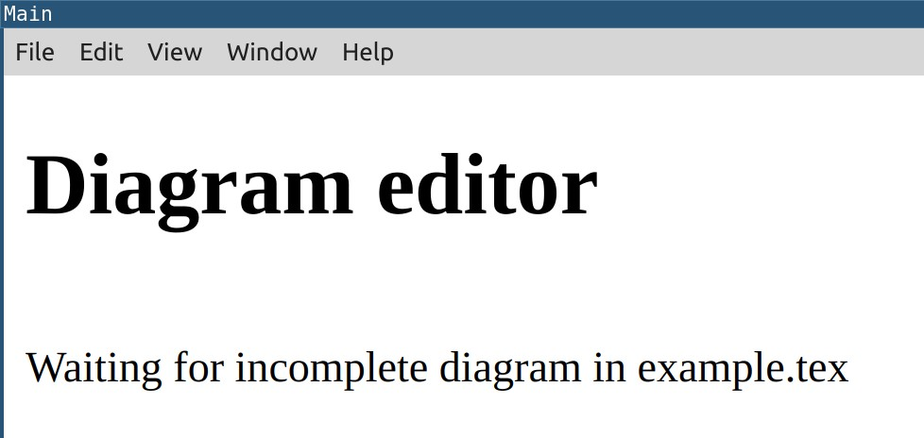
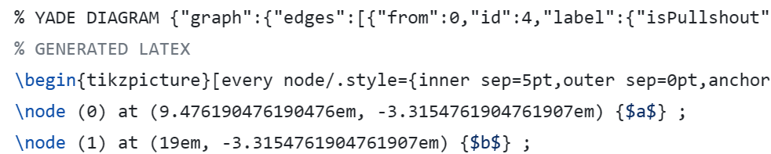
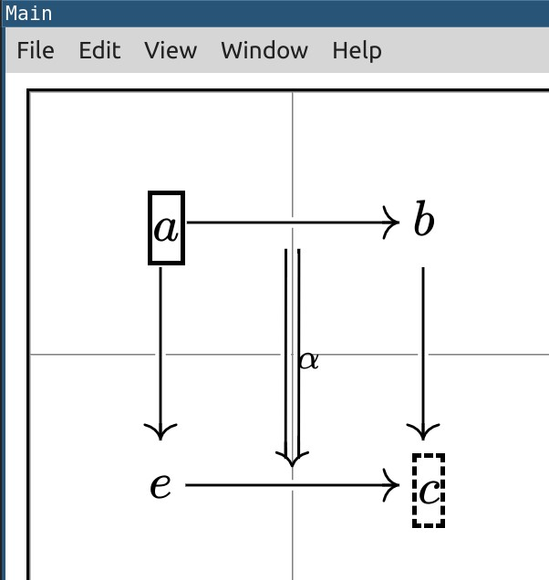
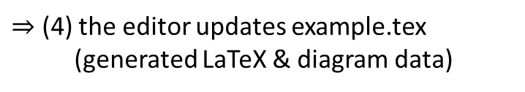
Easy editing of LaTeX diagrams
diagram data
example.tex
standalone version, running in the background
(1) Remove the generated latex
$⇒$ (2) the editor loads the diagram
(3) Edit & Save the diagram in the editor
$⇒$ (4) the editor updates example.tex
(generated LaTeX & diagram data)
DEMO

Slide 12
Comparison with quiver
 | Quiver | My editor
Programming Languages | JavaScript + React
Styling options | + | -
User-friendly | + | -
Editing features | - | + Tabs, Copy & paste, find & replace, expand selection to connected components, …
LaTeX export | yes | yes

Slide 13
Comparison with quiver
 | Quiver | My editor
Programming Languages | JavaScript + React
Styling options | + | -
User-friendly | + | -
Editing features | - | + Tabs, Copy & paste, find & replace, expand selection to connected components, …
LaTeX export | yes | yes
A nice name | + | -

Slide 14
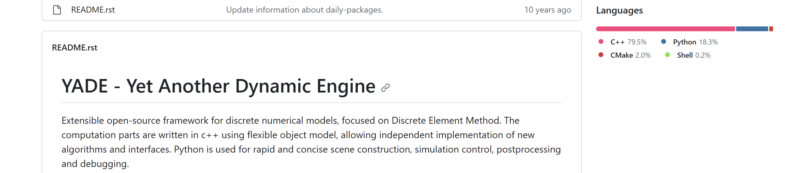
I used to call my editor YADE.
Yet Another Diagram Editor
This is already taken☹️
Notes:
Anecdote avec Tom, le package

Slide 15

Now I call it Coreact YADE 🤔
ANR Project¹ (2023 - 2027): Coq-based Rewriting: Towards Executable Applied Category Theory
Develop and maintain an interactive Coq-based wiki system for categorical rewriting theory
Led by N. Behr (IRIF)
Involving (at LIX): myself, S. Mimram, B. Werner, N. Zeilberger.
¹ https://coreact.wiki/
Notes:
Avant d’expliquer le rapport avec ce que je fais presenter Coq

Slide 16
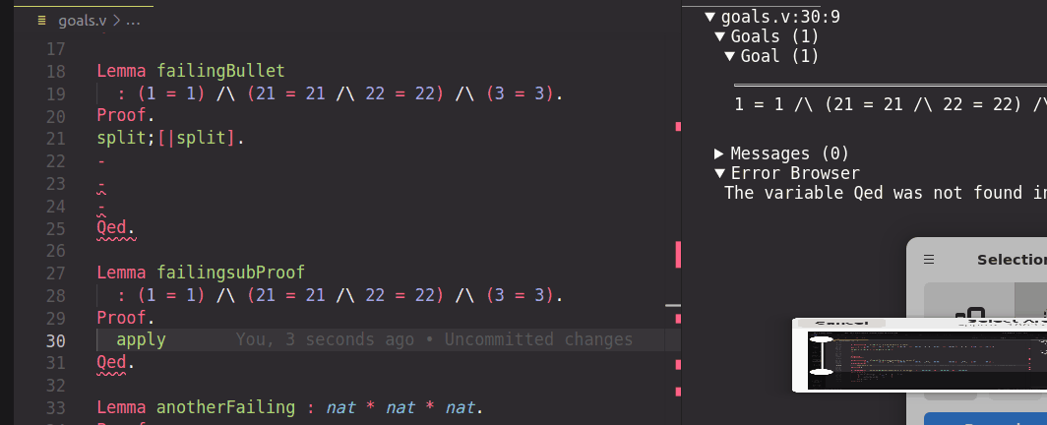

The Coq proof assistant
A software to write formal proofs interactively
File editor, e.g., Visual Studio Code + coq-lsp extension
Coq
Edited file
Feedback from Coq
There is also a web version of Coq (no installation required): https://coq.vercel.app/

Slide 17
Comparison with quiver
 | Quiver | My editor
Programming Languages | JavaScript + React
Styling options | + | -
User-friendly | + | -
Editing features | - | + Tabs, Copy & paste, find & replace, expand selection to connected components, …
LaTeX export | yes | yes
A nice name | + | -

Slide 18
Comparison with quiver
 | Quiver | My editor
Programming Languages | JavaScript + React
Styling options | + | -
User-friendly | + | -
Editing features | - | + Tabs, Copy & paste, find & replace, expand selection to connected components, …
LaTeX export | yes | yes
A nice name | + | -
Mechanisation features | - | +

Slide 19



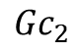


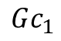
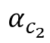

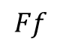

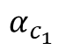
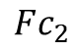
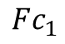
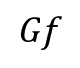
Diagrammatic reasoning in category theory
Definition of a natural transformation $α:F⇒G$ ?
A family of morphisms ${\left(α_{c}:Fc→Gc\right)}_{c}$ such that:
Computer-friendly (text)
Diagrammatically,
$$α_{c_{1}}$$
$$Fc_{1}$$
$$Gc_{1}$$
=
$$∀f:c_{1}→c_{2}, {Ff∘α}_{c_{1}}=α_{c_{2}}∘Gf$$
Or is it$Ff∘α_{c_{2}}=α_{c_{1}}∘Gf$?
$$Ff$$
=
$$Gf$$
Or is it $Gf∘α_{c_{2}}=α_{c_{1}}∘Ff$?
$$Fc_{2}$$
$${Gc}_{2}$$
$$α_{c_{2}}$$
$$Gf∘α_{c_{1}}=α_{c_{2}}∘Ff$$
…unless $∘$ is defined the other way around

Slide 20

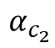
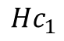
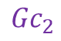

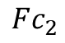
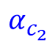
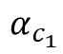
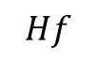
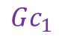
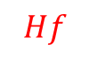
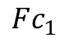
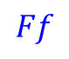
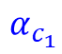
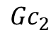
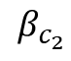
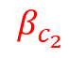
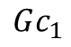
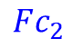
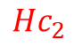
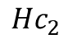
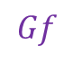
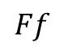
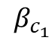
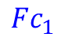
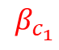
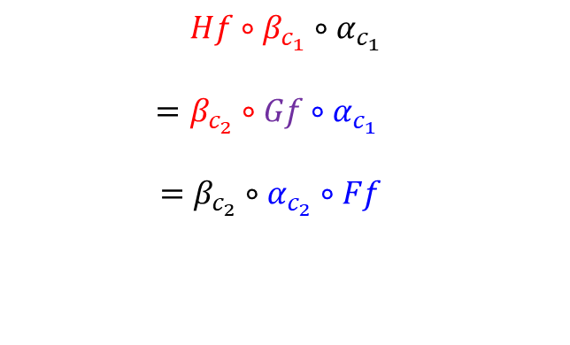
Natural transformations compose:
If $α:F⇒G$ and $β:G⇒H$ are natural, then so is ${\left(β_{c}∘α_{c}:Fc→Hc\right)}_{c}$
Automatic generation?
Diagrammatic proof
Computer-friendly proof
$$α_{c_{1}}$$
$$β_{c_{1}}$$
$$Fc_{1}$$
$$Gc_{1}$$
$$Hc_{1}$$
YADE
$$Ff$$
?
$$Hf$$
$$Hf∘β_{c_{1}}∘α_{c_{1}}$$
$$=β_{c_{2}}∘Gf∘α_{c_{1}}$$
$=β_{c_{2}}∘α_{c_{2}}∘Ff$
$$Fc_{2}$$
$${Gc}_{2}$$
$${Hc}_{2}$$
$$α_{c_{2}}$$
$$β_{c_{2}}$$
$$α_{c_{1}}$$
$$β_{c_{1}}$$
$$Fc_{1}$$
$$Gc_{1}$$
$$Hc_{1}$$
$$Ff$$
=
$$Gf$$
=
$$Hf$$
$$Fc_{2}$$
$${Gc}_{2}$$
$${Hc}_{2}$$
$$α_{c_{2}}$$
$$β_{c_{2}}$$

Slide 21
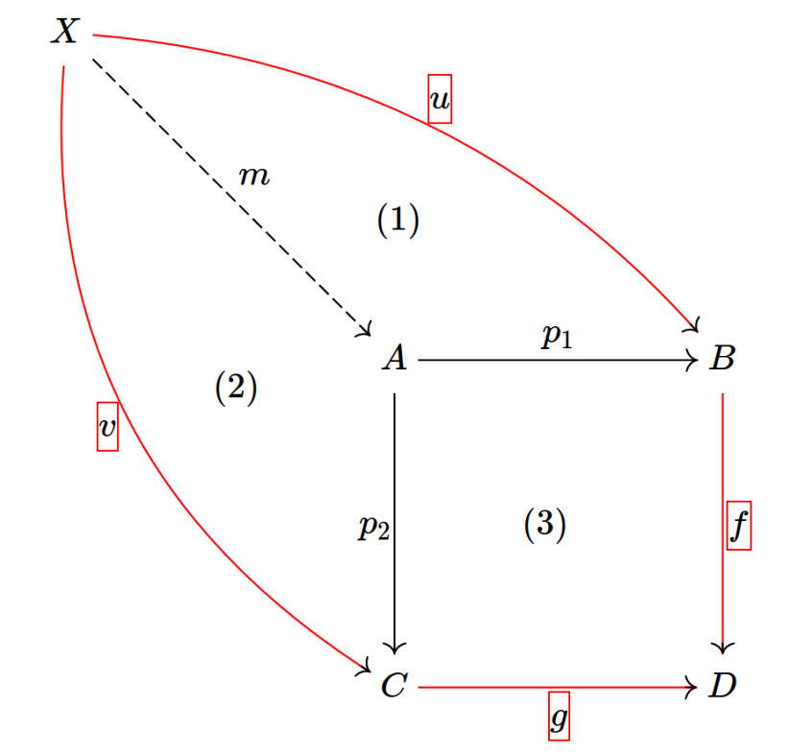
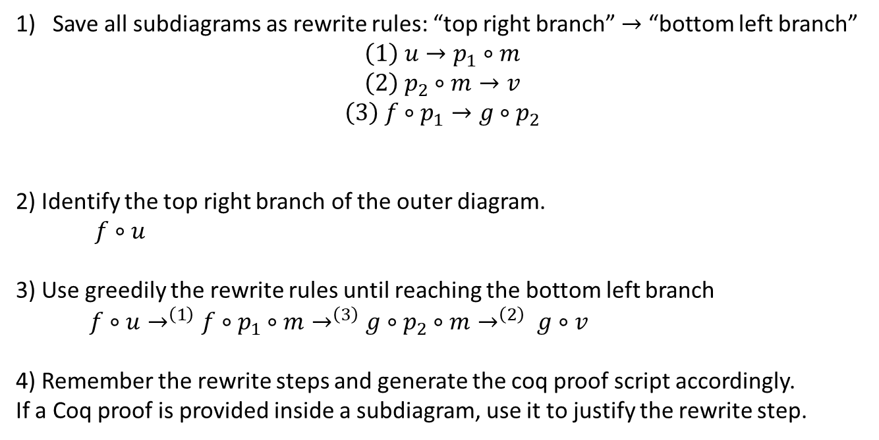
Proof generation: sketch of the algorithm
Save all subdiagrams as rewrite rules: “top right branch” $→$ “bottom left branch”
$$\left(1\right) u→p_{1}∘m$$
$$\left(2\right) p_{2}∘m→v$$
$$\left(3\right) f∘p_{1}→g∘p_{2}$$
2) Identify the top right branch of the outer diagram.
$f∘u$
3) Use greedily the rewrite rules until reaching the bottom left branch
$f∘u→^{\left(1\right)}f∘p_{1}∘m→^{\left(3\right)}g∘p_{2}∘m→^{\left(2\right)} g∘v$
4) Remember the rewrite steps and generate the coq proof script accordingly.
If a Coq proof is provided inside a subdiagram, use it to justify the rewrite step.

Slide 22

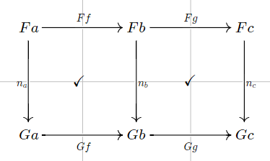
Architecture
Diagram editor
(standalone version)
Custom vscode extension
(building upon coq-lsp)
Visual Studio Code
Generate proofs
Show diagram
under cursor
Construct diagrams step by step
(+ Coq library for custom notations)

Slide 23
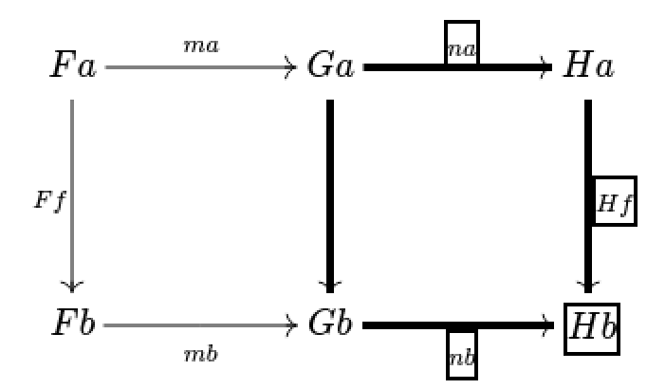
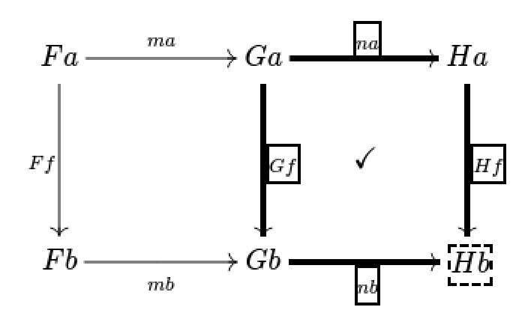

Construction of a diagrammatic proof with Coq + YADE
1) Select a subdiagram
2) Execute the export command in the diagram editor
unnamed arrow
$⇒$ vscode asks for a Coq proof of equality
eassert (yade : { {n a} · H f = {_} · {n b} }). { (* Coq proof to be written here by the user *) }
4) Complete the proof (here, by invoking naturality of $n$)
5) Execute the export command in vscode
$⇒$ The diagram gets completed in the editor window:
The label of the unnamed arrow is inferred
The Coq proof is saved in the diagram (indicated by ✓)

Slide 24

Another related software for mechanisation:
Luc Chabassier’s interface for diagrammatic proofs
Goal, assumptions, lemmas
Graphical interface
(standalone program,
implemented in Rust)
Coq plugin
(ocaml)
Lemma …
Proof.
…
diagram server.
Coq proof term
(implicit)
Automatic layout (limited manual editing)
Proof tactics (including invoking a lemma)
I plan to use his plugin in the future
(to apply Coq lemmas directly in the editor)

Slide 25
Comparison with quiver
 | Quiver | YADE
Programming Languages
Styling options | + | -
User-friendly | + | -
Editing features | - | + Tabs, Copy & paste, find & replace, expand selection to connected components, …
LaTeX export | yes | yes
A nice name | + | -
Mechanisation features | - | +

Slide 26
Comparison with quiver
 | Quiver | YADE
Programming Languages
Styling options | + | -
User-friendly | + | -
Editing features | - | + Tabs, Copy & paste, find & replace, expand selection to connected components, …
LaTeX export | yes | yes
A nice name | + | -
Mechanisation features | - | +
Popularity | +++
Two users: me and Tom Hirschowitz

Slide 27
Some future plans
Improve the process for building diagrams using Coq + YADE
(I still find it tedious)
Formalise categorical results.
A collaborative online version the editor
(requires a lot of engineering)
Support for mechanisation of 2-categorical diagrams, string diagrams

Slide 28
How to try Coreact-YADE
Requirements for the full example available on github¹
Package manager for ocaml softwares / libraries
opam
Installation is a bit tedious.
Coq-lsp runtime
Handles communication between vscode and Coq
Hierarchy builder
A coq library to help building algebraic hierarchies
(e.g. categories)
Coreact-yade extension
Packaged as .deb (Debian amd64)
or .img (MacOS arm64)
Coq
Visual Studio Code
Coreact-YADE
¹ https://github.com/amblafont/vscode-yade-example

Slide 29
How to make YADE easier to install?
The lazy way:
Distribute an “image” of an OS with everything installed, for some emulation software
✓ No need to change the implementation
✖ Still requires to install the emulation software
✖ Images can be big (several GBs).
The clean way:
Embed YADE in (the web version of) vscode
✓ No installation:
run vscode + coq + YADE in your browser
✖ Requires a lot of engineering.
The very lazy way:
Distribute an installation script to build the “image” on the user machine
✓ No need to host the (big) image
✖ Less robust
What I did

Slide 30
Testing YADE in an emulated environment
can run an image of a full OS (e.g., Debian) on any host operating system (Windows / Mac / Linux)
Virtual Box
Docker
✓ Better performance (probably not very relevant for YADE)
✓ A modular system to build new images
recipes are called dockerfiles
a dockerfile can extend another one
✖ Not readily cross-platform
✖ Configuration is complex (especially for GUI images)
✓ Easy to install
✖ Big image size
Installation script
Installation script
A shell script to be run in a fresh Debian image¹
A dockerfile (extending that of coq)
Check https://github.com/amblafont/vscode-yade-example for instructions!
¹https://www.linuxvmimages.com/

